Slide 1

MOBILE STRATEGY GAME PREDICTOR
B128 TEAM 3
Joy Kuan (U2221261D)
Joelle (U2220706H)
Olery Ng (U2222376A)
001

Slide 2
002
MOTIVATIONS

Slide 3
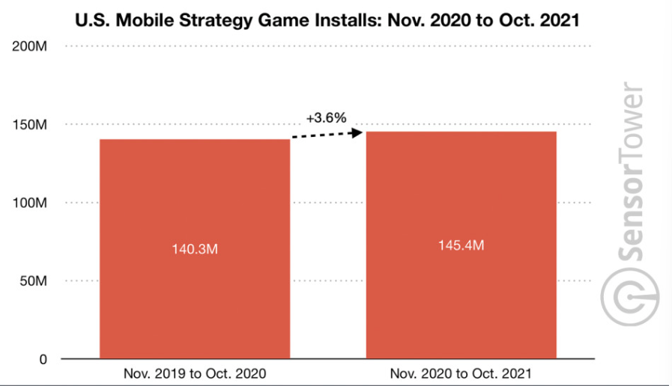
INCREASING POPULARITY OF MOBILE STRATEGY GAMES
Source: SensorTower(2021)
Data source: SensorTower and data.ai – mobile intelligence providers.
Notes:
From SensorTower, we found that during the year 2020 to 2021, there was an increase in the number of downloads of these mobile strategy games.
https://sensortower.com/blog/us-mobile-strategy-4-point-2-billion-revenue

Slide 4
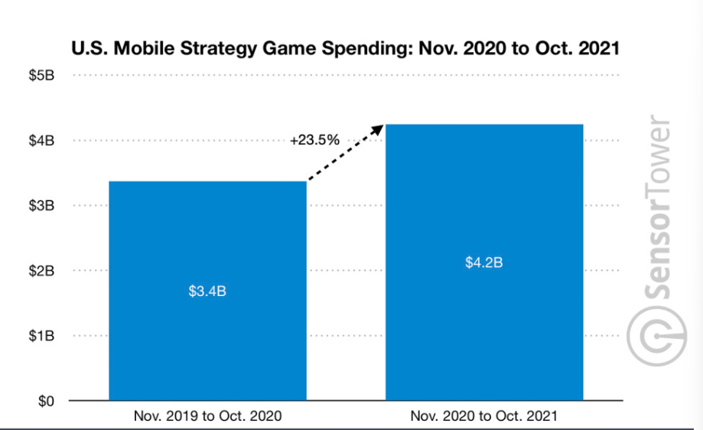
RISE IN SPENDING ON MOBILE STRATEGY GAMES
Source: SensorTower(2021)
Notes:
Besides an increase in the number of download, we also found that during that period, there was a rise in spending, where Players spending in mobile Strategy games in the United States rose by 23.5 percent from $3.4 billion to $4.2 billion

Slide 5
22.01 billion
33.01 billion
In the year 2022,
Projected to earn
by 2027

Slide 6
WHAT QUALITIES MAKE A STRATEGY GAME POPULAR
001
Notes:
Can rephrase/ think of a better one?

Slide 7
CONTENT PAGE
001
002
003
004
005
006
Data Cleaning
Data Preparation
Exploratory Data Analysis
Model Training
Conclusion
Learning Points
001
002

Slide 8
01
DATA CLEANING

Slide 9
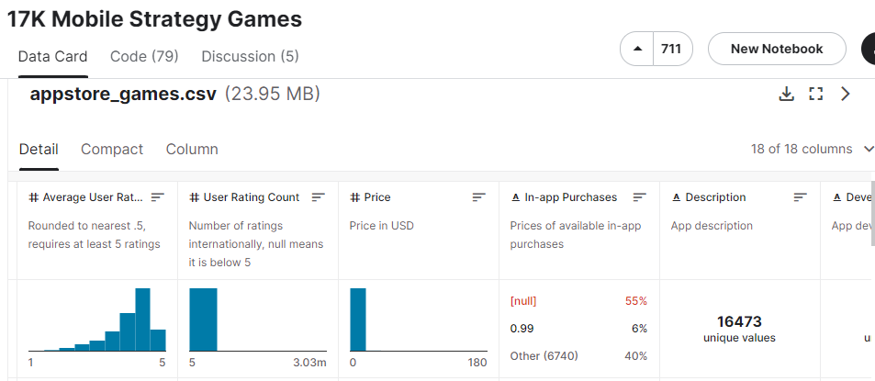
Dataset
From Kaggle:
Notes:
Dataset Name: 17K Mobile Strategy Games
This is the data of 17007 strategy games on the Apple App Store. It was collected on the 3rd of August 2019, using the iTunes API and the App Store sitemap.

Slide 10
DATASET COLLECTION
File name: appstore_games.csv
Variables Removed:
URL ; ID ; Subtitle ; Icon URL ; Description ; Size ; Primary Genre
Current Dataset:
Name; Average User Rating; User Rating Count; Price; In-app Purchases; Developer; Age Rating; Languages; Genres; Original Release Date; Current Version Release Date

Slide 11
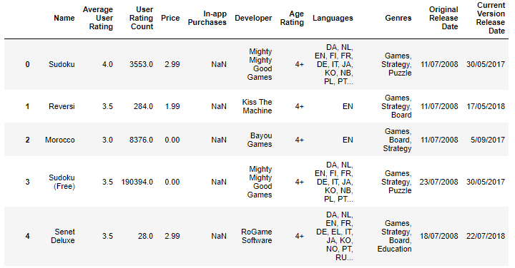
DATASET COLLECTION
Current Dataset - After Removing irrelevant variables:

Slide 12
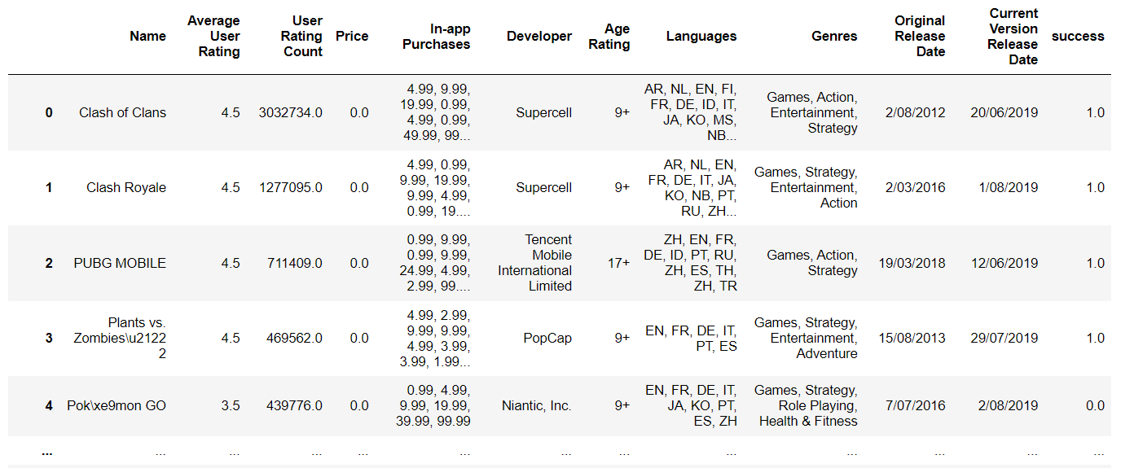
DATASET COLLECTION
Labelled games as either “successful”(1) or “unsuccessful”(0)
Criteria of a successful game
User Rating Count : >4000
Average User Rating: >= 4
Extracted “successful” games into a new dataframe (games_clean)

Slide 13
02
DATA PREPARATION

Slide 14
DATASET PREPARATION
Alterations made on the Variables:
Genre
Language
Original Release Date & Current Version Release Date
Notes:
Alteration made on the variables:
Genre:
We removed “games” from the string
Then we split the genre string based on the “,” into a new column called “GenresList” containing the genres in a list format.
Languages:
Then we split the Language string based on the “,” into a new column called “LanguagesList” containing the languages in a list format.
Original Release Date:
Changed the data type to datetime and only kept the release year
Price:
Created a new column “pricetype” where free games == 0, and paid games == 1 (any game price that is not 0.00)

Slide 15

DATASET PREPARATION
Genres
Problem:
“Games” was included in all the rows
The variable is in a string format
Solution:
Remove the word “Games,” at the start of the string
Split the string using “,” and
Create a new column “GenresList” to store the genres in as a list
Notes:
Alteration made on the variables:
Genre:
We removed “games” from the string
Then we split the genre string based on the “,” into a new column called “GenresList” containing the genres in a list format.
Languages:
Then we split the Language string based on the “,” into a new column called “LanguagesList” containing the languages in a list format.
Original Release Date:
Changed the data type to datetime and only kept the release year
Price:
Created a new column “pricetype” where free games == 0, and paid games == 1 (any game price that is not 0.00)

Slide 16

DATASET PREPARATION
Language
Problem:
The variable is in a string format
Solution:
Split the string using “,” and
Create a new column “LanguagesList” to store the languages in as a list
Notes:
Alteration made on the variables:
Genre:
We removed “games” from the string
Then we split the genre string based on the “,” into a new column called “GenresList” containing the genres in a list format.
Languages:
Then we split the Language string based on the “,” into a new column called “LanguagesList” containing the languages in a list format.
Original Release Date:
Changed the data type to datetime and only kept the release year
Price:
Created a new column “pricetype” where free games == 0, and paid games == 1 (any game price that is not 0.00)

Slide 17
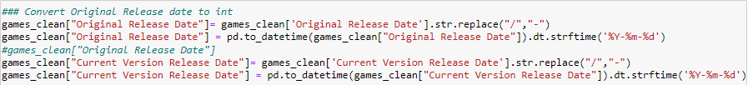
DATASET PREPARATION
Original Release Date & Current Version Release Date
Problem:
The date is in string format
The date uses “/” but Jupyter only recognised date by “-”
Solution:
Replace the “/” for “-”
Change the date from string to date time
Notes:
Alteration made on the variables:
Genre:
We removed “games” from the string
Then we split the genre string based on the “,” into a new column called “GenresList” containing the genres in a list format.
Languages:
Then we split the Language string based on the “,” into a new column called “LanguagesList” containing the languages in a list format.
Original Release Date:
Changed the data type to datetime and only kept the release year
Price:
Created a new column “pricetype” where free games == 0, and paid games == 1 (any game price that is not 0.00)

Slide 18
03
EXPLORATORY DATA ANALYSIS & VISUALIZATION

Slide 19
ANALYSIS MADE
DISTRIBUTIONS
USER COUNT
GENRE TREND
FREE VS PAID
Genres
Language
Developers
Average Rating based on Genre
Price
Age Rating
Number of games with that genre released over the years
Age Rating
Add-ons
Average User Rating

Slide 20
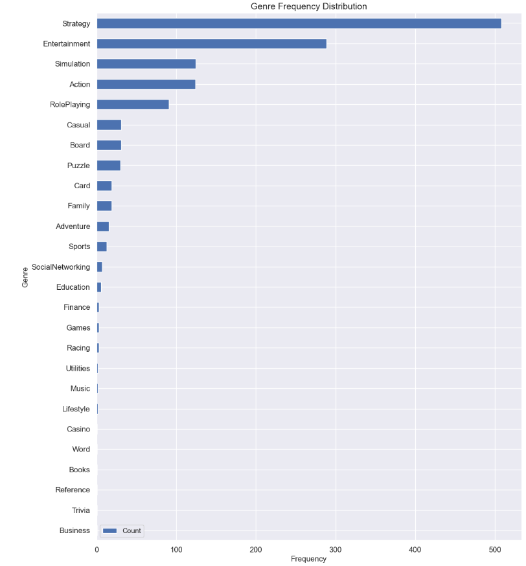
DISTRIBUTION OF GENRES
Popular Genres:
Entertainment games, Simulation games, and Action
Unpopular Genres:
Business, Trivia, Reference, Books, Word, Casino
002

Slide 21
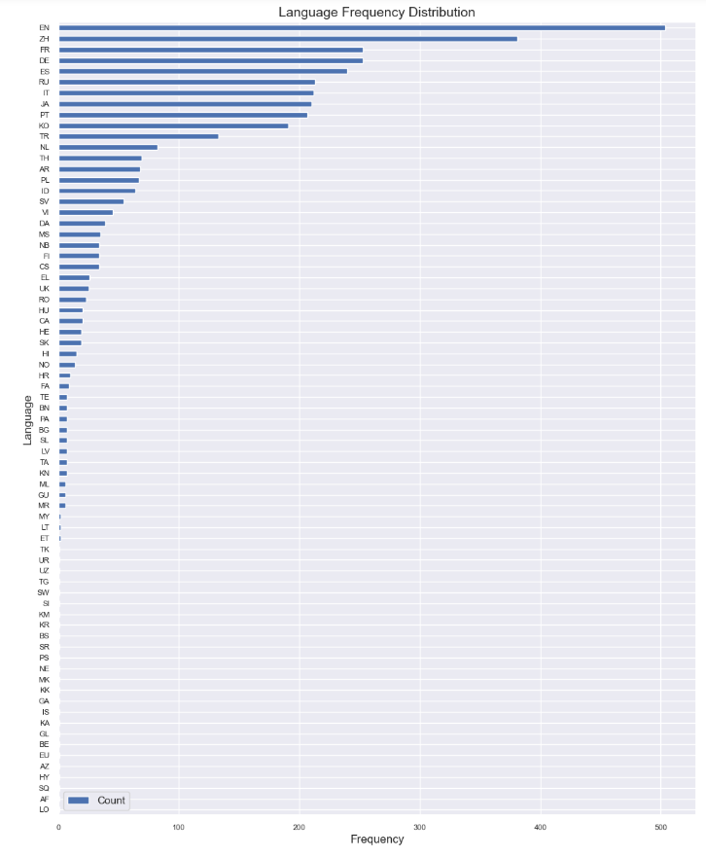
DISTRIBUTION OF LANGUAGES
Popular Language:
English & Chinese(ZH)
002

Slide 22
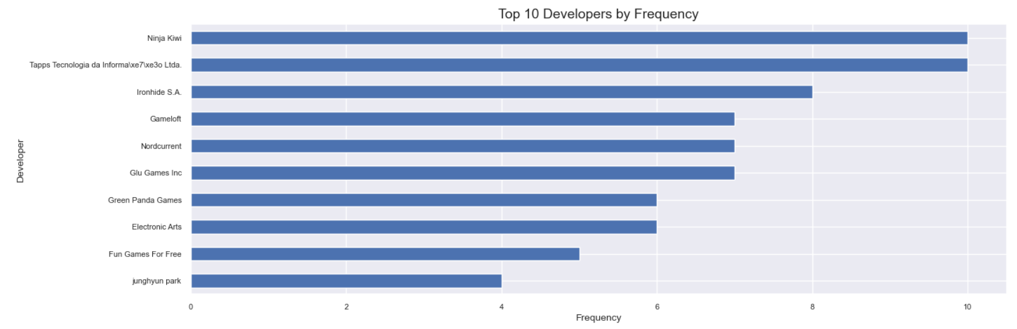
DISTRIBUTION OF DEVELOPERS
002
Notes:
Popular developers: Ninja Kiwi, Tapps Tec, Ironhide S.A
The developer “Supercell”, although appeared 3 times in the”successful” game list, developed games that are currently ranked 1, 2, 6.

Slide 23
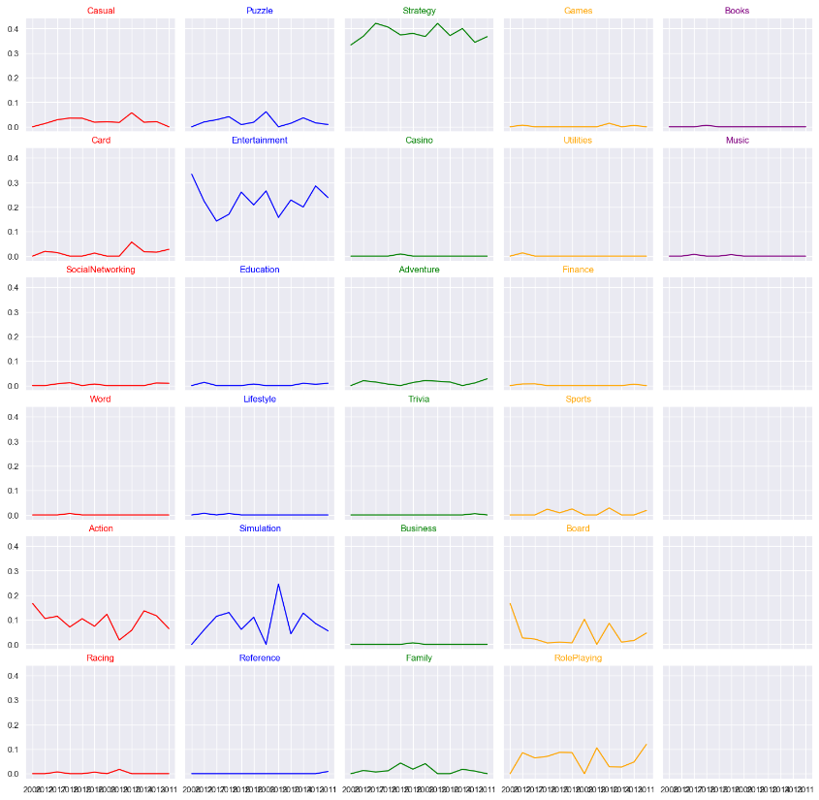
GENRE TREND
PROPORTION OF GAMES RELEASED BASED ON GENRE OVER THE YEARS
Role-playing has an upward trend
Although on a declining trend, many Entertainment, Action, and Simulation genre of games are still released.

Slide 24
USER RATING COUNT VS ____
001
002
003
PRICE
AVERAGE RATING BASED ON GENRE
AGE RATING
001
002
003

Slide 25
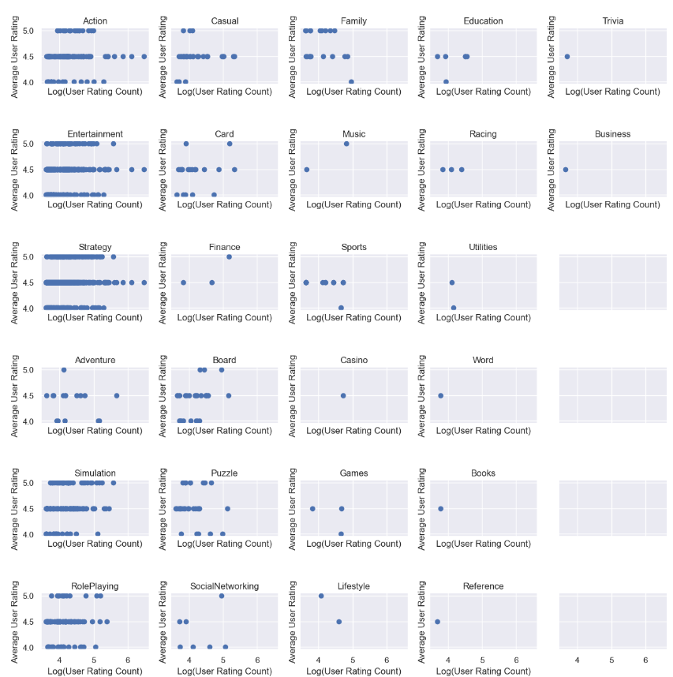
USER RATING COUNT VS
AVERAGE USER RATING BASED ON GENRES
- The genres Action and Entertainment seems to have games with high user rating count with relatively high user rating of 4.5 .
- Games with genre Trivia, Business, Word, Books, Reference have only 1 game in this dataset, an average user rating of 4.5 and have a relatively low user rating count

Slide 26
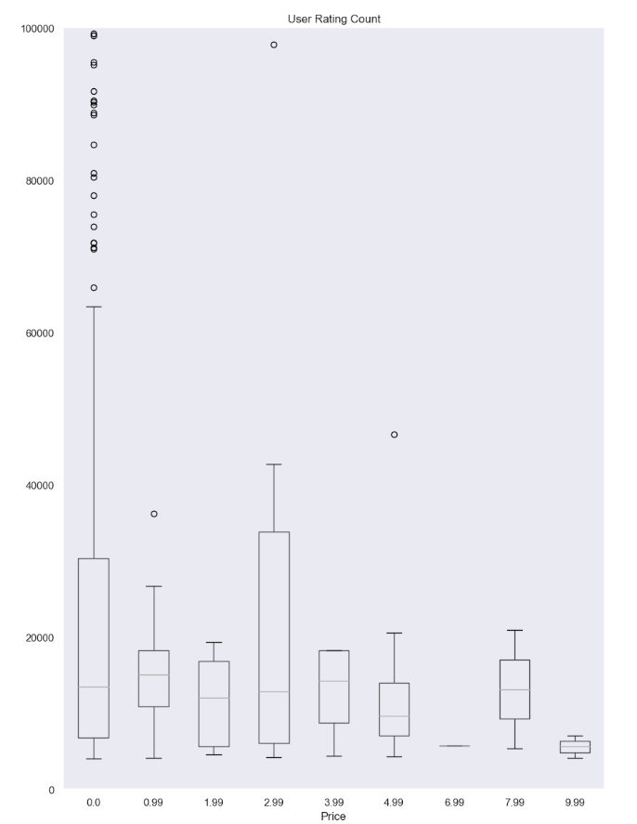
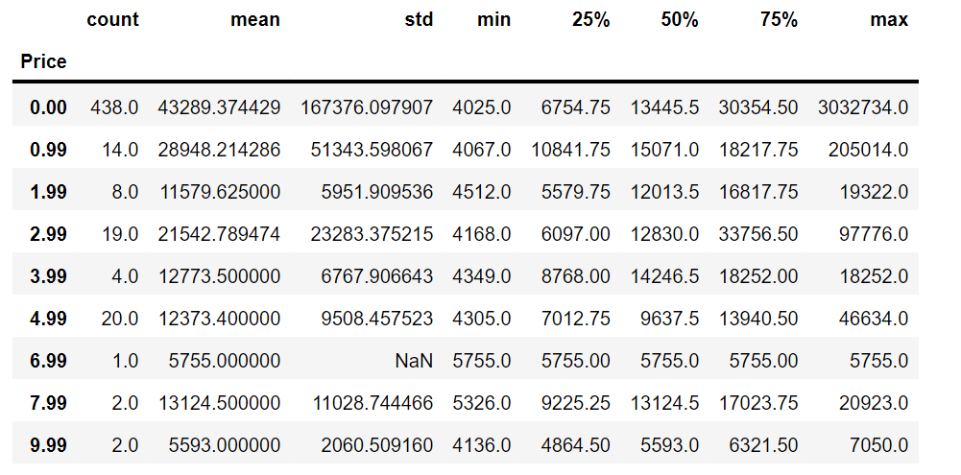
USER RATING COUNT VS
PRICE
Notes:
We set a limit on the y axis to 10,000 so that the boxplot can be shown more clearly. By doing this only the extreme outliers from games with the price $0.00 are affected/cut off

Slide 27
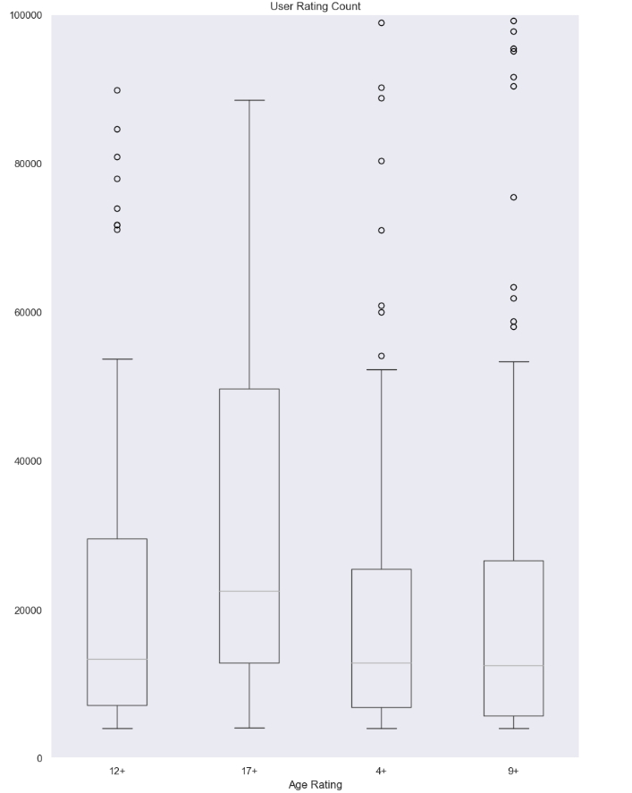
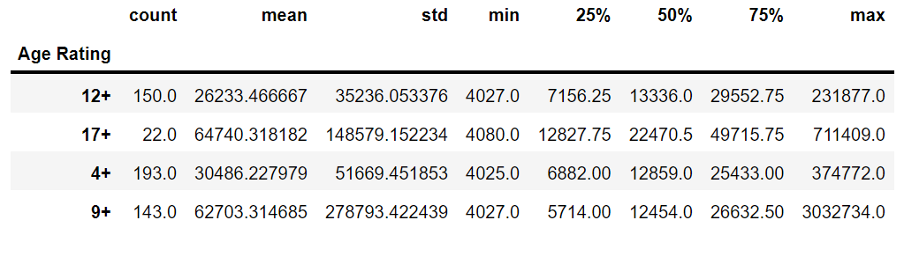
USER RATING COUNT VS
AGE RATING

Slide 28
FREE VS PAID GAMES
001
002
003
ADD-ONS
AGE RATING
USER RATING
001
002
003

Slide 29
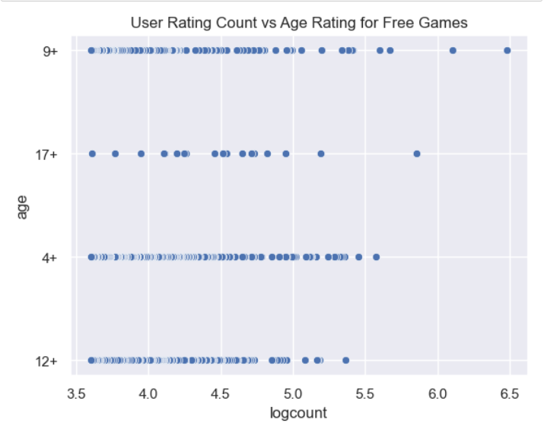
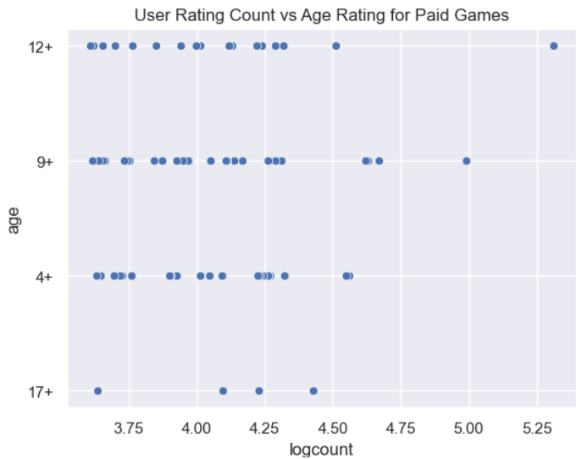
USER RATING COUNT VS AGE RATING
FREE VS PAID GAMES
002

Slide 30
ANALYSIS
For both price types,
not many games have the age rating of 17+
games with 9+ age rating have a higher user count
Free games with the age rating of 4+ and 9+ tend to have a higher user rating count
002

Slide 31
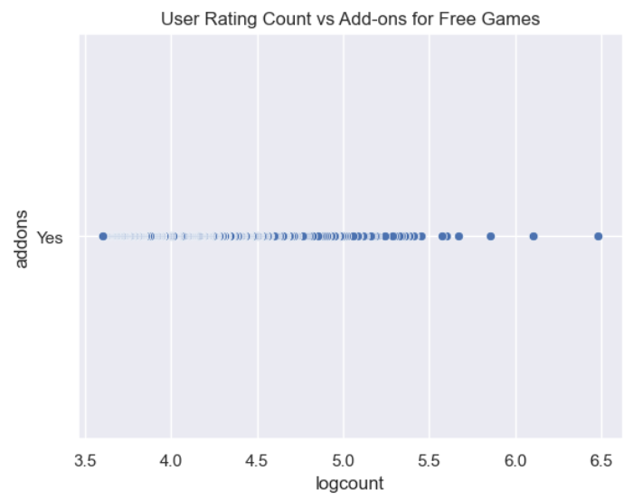
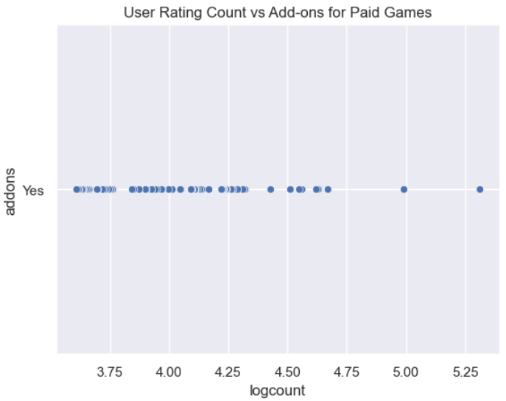
USER RATING COUNT VS ADD-ONS
FREE VS PAID GAMES
002

Slide 32
ANALYSIS
Both free and paid games within the “successful” game dataset all have add-ons to their game
This suggest that games with add-ons are more likely to succeed
002

Slide 33
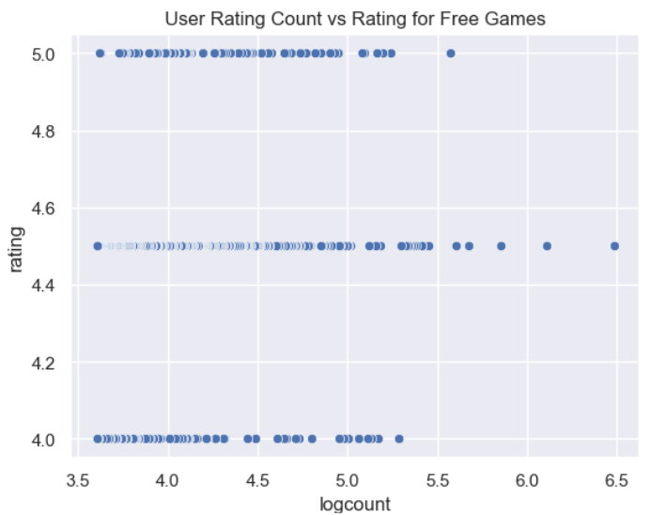
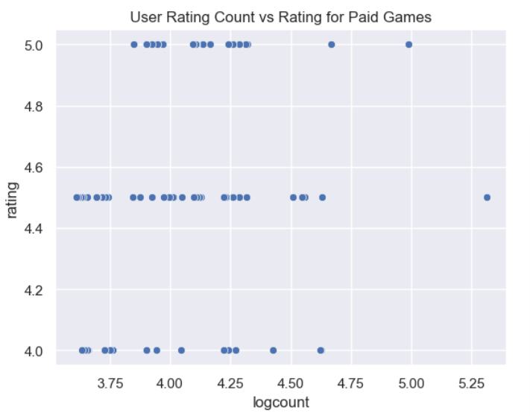
USER RATING COUNT VS USER RATING
FREE VS PAID GAMES
002

Slide 34
ANALYSIS
- There exists more free games with an average user rating of 4.5 and above, as compared to paid games
- This suggests that a free game is more likely to perform in comparison to a paid one
002

Slide 35
04
MODEL TRAINING

Slide 36
CONTENTS
001
002
003
DECISION TREE
LINEAR
REGRESSION
RANDOM FOREST
001
002
003

Slide 37
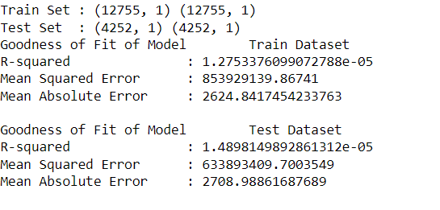
LINEAR REGRESSION BETWEEN PRICE AND AVERAGE USER RATING
002

Slide 38
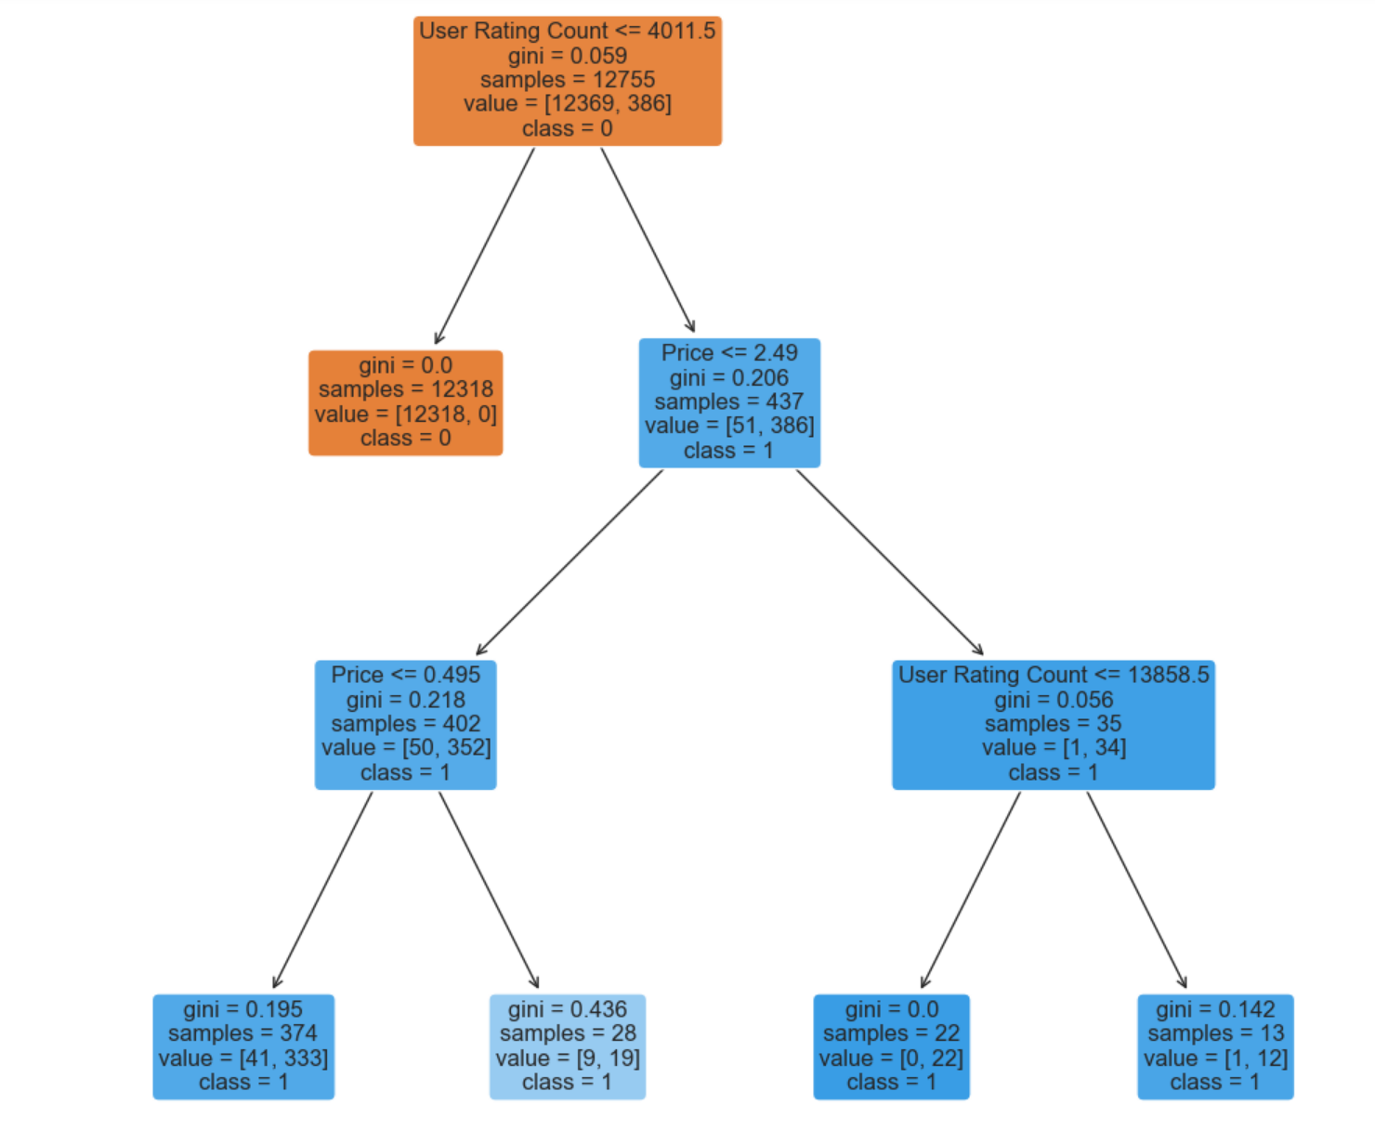
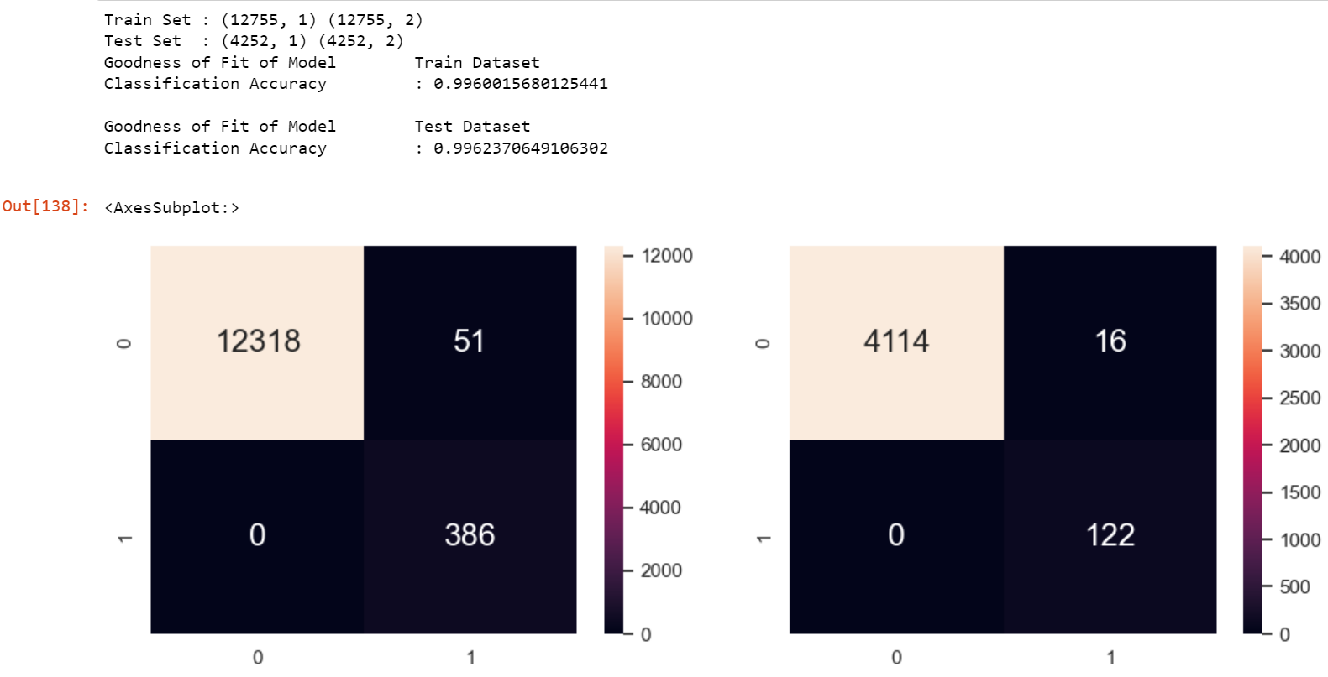
ANALYSIS
- The existing decision tree is shown to be highly accurate, because "User Rating Count" is utilised as a predictor. As "User Rating Count" was initially one of the conditions used to determine whether a game is considered to be successful
- As the majority of the variables in the dataset with correlations with a game's success were categorical, we were ultimately only able to utilise 2 predictors in this decision tree
002

Slide 39
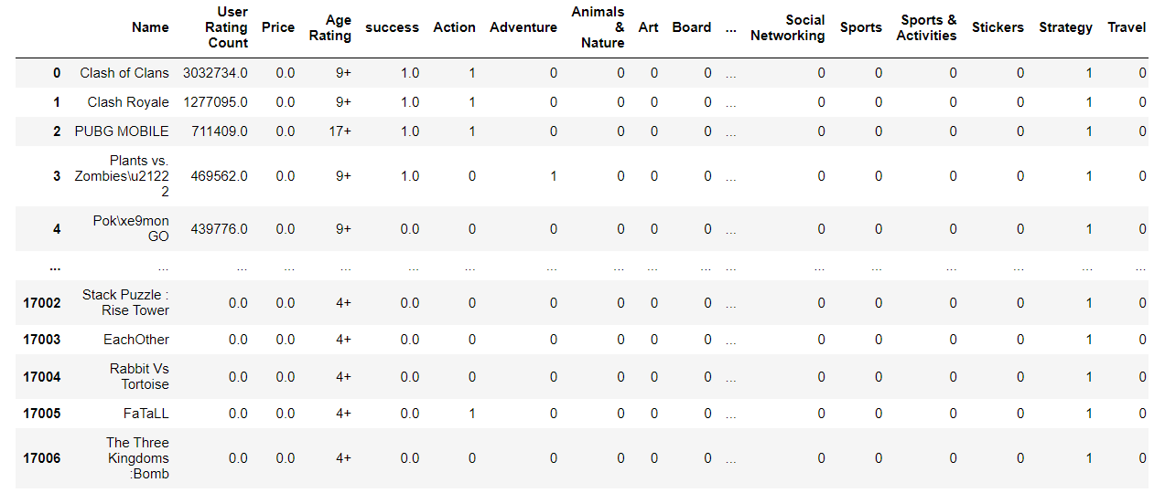
ONE HOT ENCODING
002
Notes:
Popular developers: Ninja Kiwi, Tapps Tec, Ironhide S.A
The developer “Supercell”, although appeared 3 times in the”successful” game list, developed games that are currently ranked 1, 2, 6.

Slide 40
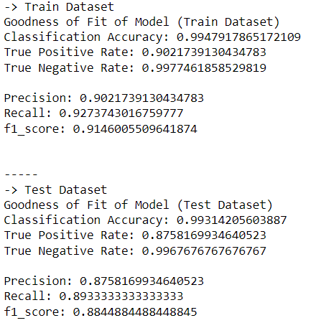


RANDOM FOREST
002
Notes:
Popular developers: Ninja Kiwi, Tapps Tec, Ironhide S.A
The developer “Supercell”, although appeared 3 times in the”successful” game list, developed games that are currently ranked 1, 2, 6.

Slide 41
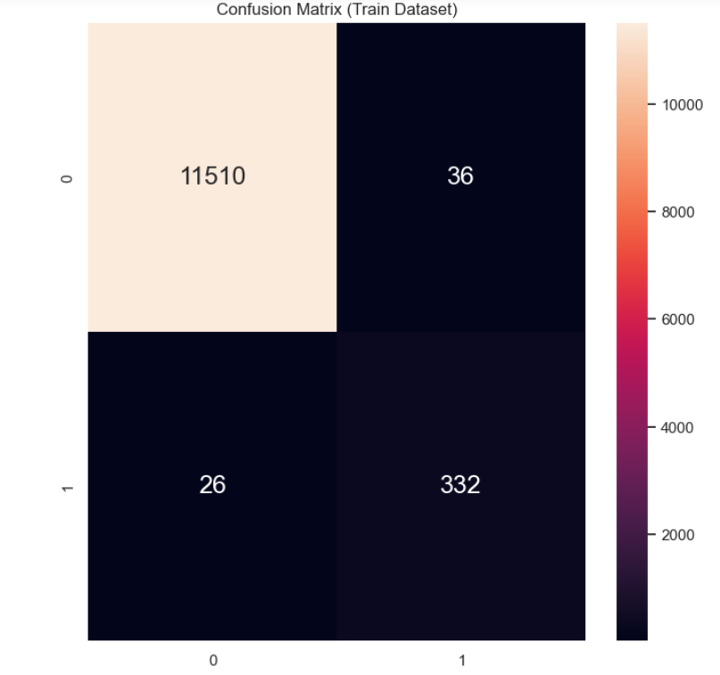
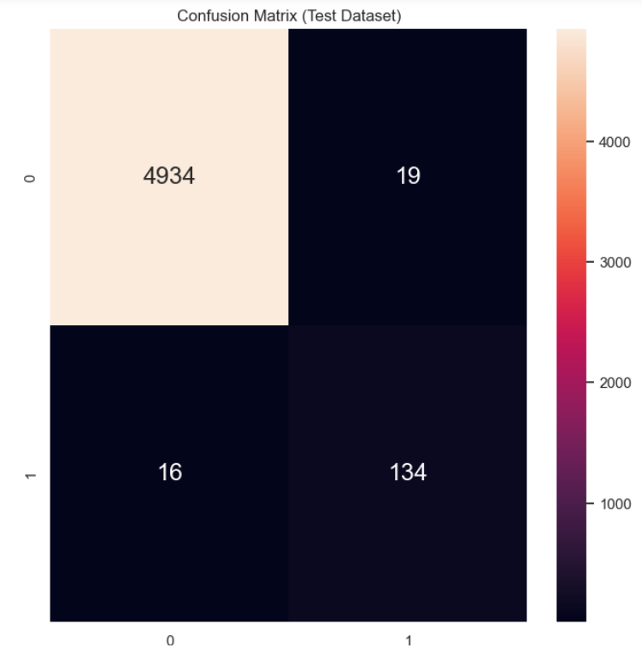
RANDOM FOREST
002
Notes:
Popular developers: Ninja Kiwi, Tapps Tec, Ironhide S.A
The developer “Supercell”, although appeared 3 times in the”successful” game list, developed games that are currently ranked 1, 2, 6.

Slide 42
05
OUTCOME

Slide 43
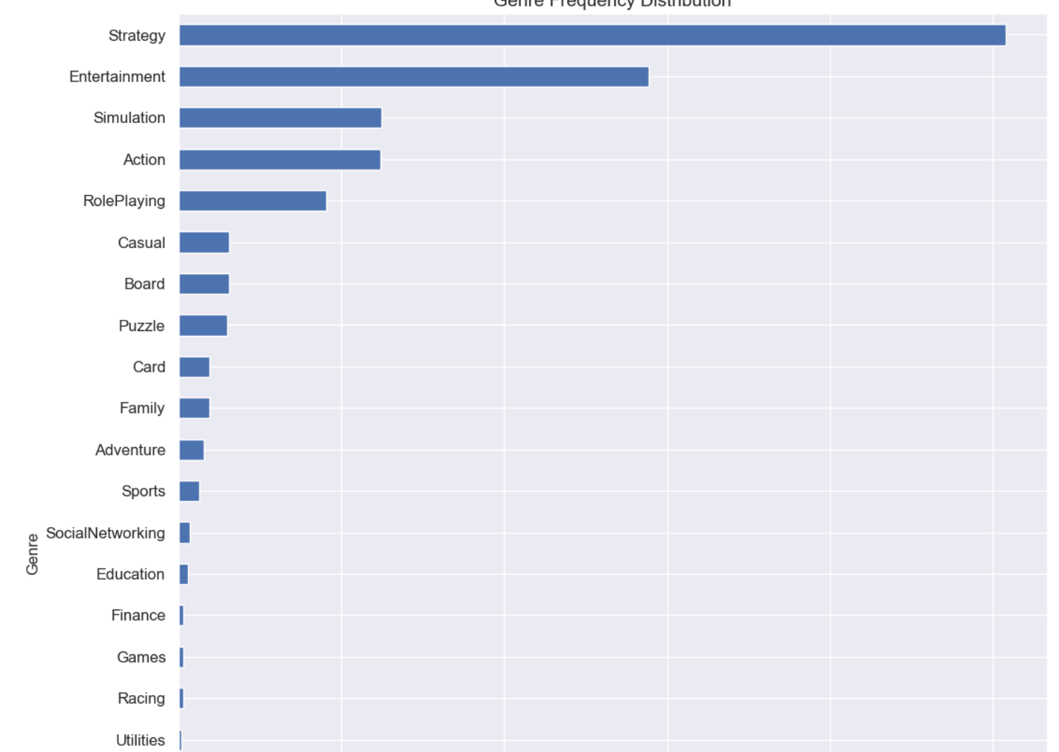
Prediction of Success
There existed clear trends as to the factors which influenced success
However these factors were categorical
We were thus limited in terms of what we could utilise in linear regression and decision trees

Slide 44
06
LEARNING POINTS

Slide 45
Insights: Characteristics of Successful Games
A large proportion of “successful” games were part of the entertainment genre
The vast majority offered language support for English and Mandarin
Frequency of developers who produced “successful” games was largely evenly distributed
A large portion of games which were considered “successful” were free, a total of 438/508
Age Rating had little influence on a games success

Slide 46
002
THANK YOU

